Slide 1
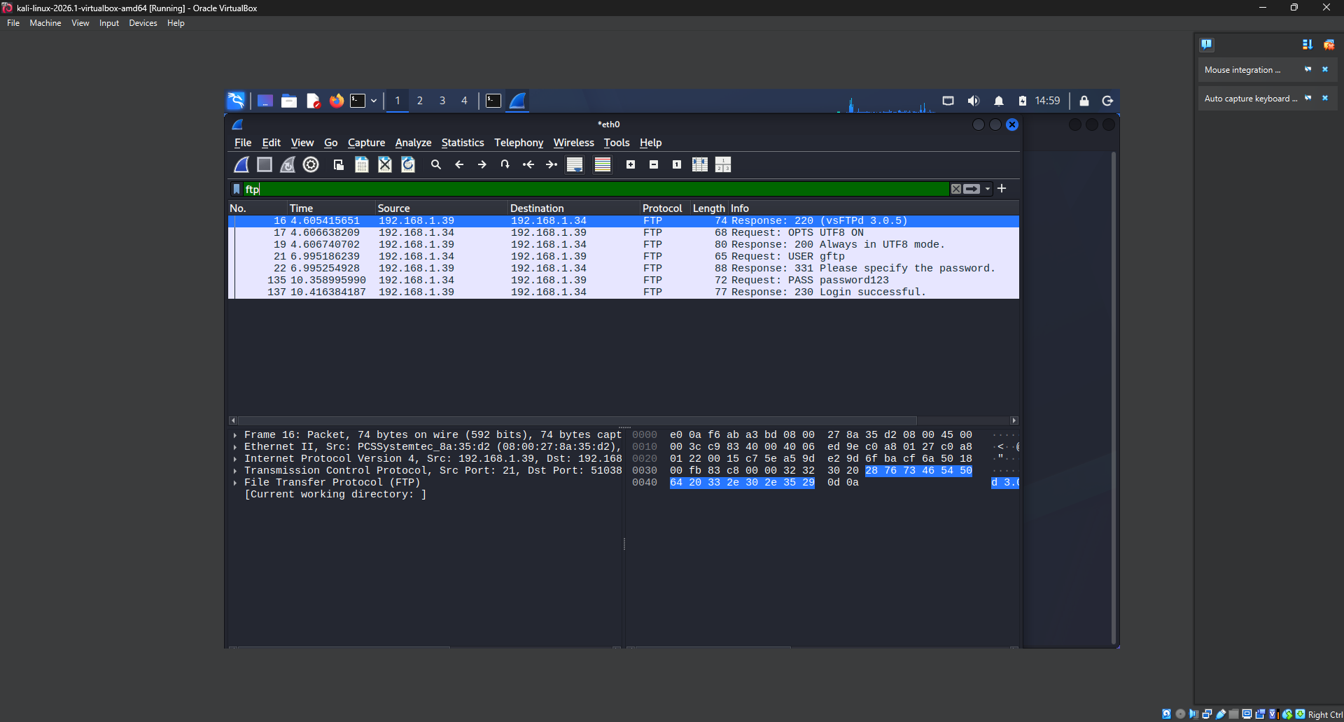
Source and dest ip
ftp user & pwd

